Slide 1
RIP version 1

Slide 2
Objectives
Describe the functions, characteristics, and operation of the RIPv1 protocol.
Configure a device for using RIPv1.
Verify proper RIPv1 operation.
Describe how RIPv1 performs automatic summarization.
Configure, verify, and troubleshoot default routes propagated in a routed network implementing RIPv1.
Use recommended techniques to solve problems related to RIPv1

Slide 3
RIPv1
RIP Characteristics
-A classful, Distance Vector (DV) routing protocol
-Metric = hop count
-Routes with a hop count > 15 are unreachable
-Updates are broadcast every 30 seconds

Slide 4
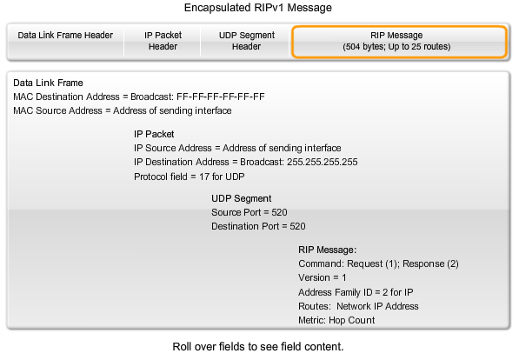
RIP v1 message

Slide 5
RIPv1
RIP Operation
  RIP uses 2 message types:
      Request message
-This is sent out on startup by each RIP enabled interface
-Requests all RIP enabled neighbors to send routing table
      Response message
-Message sent to requesting router containing routing table

Slide 6
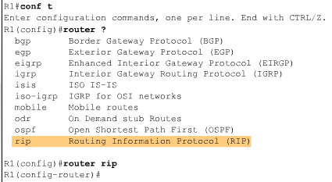
Basic RIPv1 Configuration
Router RIP Command
  To enable RIP enter:
  -Router rip at the global configuration prompt
  -Prompt will look like R1(config-router)#

Slide 7
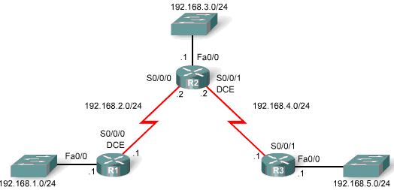
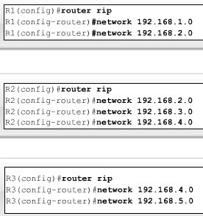
Basic RIPv1 Configuration
Specifying Networks
  Use the network command to:
  -Enable RIP on all interfaces that belong to this network
  -Advertise this network in RIP updates sent to other routers every 30 seconds

Slide 8
Verification and Troubleshooting
To verify and troubleshoot routing
-Use the following
commands:
-show ip route
-show ip protocols
-debug ip rip

Slide 9
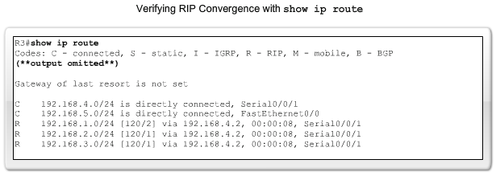
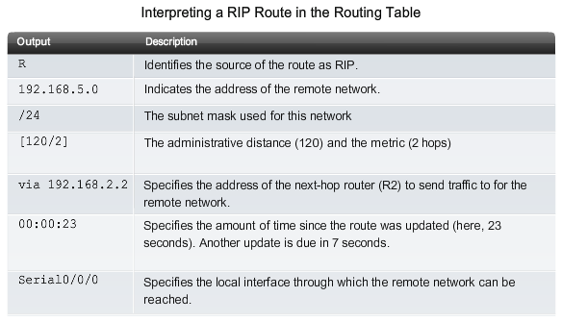
Interpreting RIP route

Slide 10
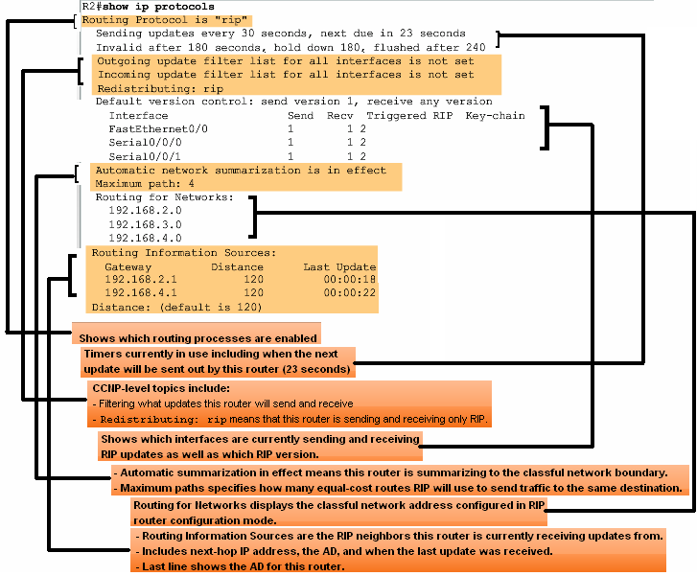
Verification and Troubleshooting
show ip protocols command
-Displays routing protocol configured on router

Slide 11
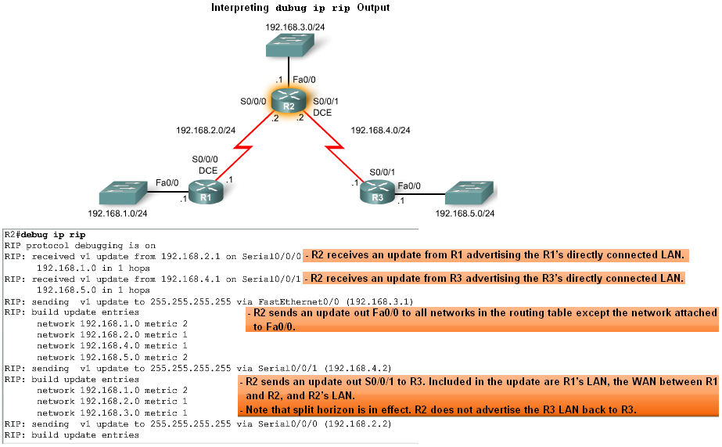
Verification and Troubleshooting
Debug ip rip command
-Used to display RIP routing updates as they are happening

Slide 12
Verification and Troubleshooting
Passive interface command
-Used to prevent a router from sending updates through an interface
-Example:
Router(config-router)#passive-interface interface-type interface-number

Slide 13
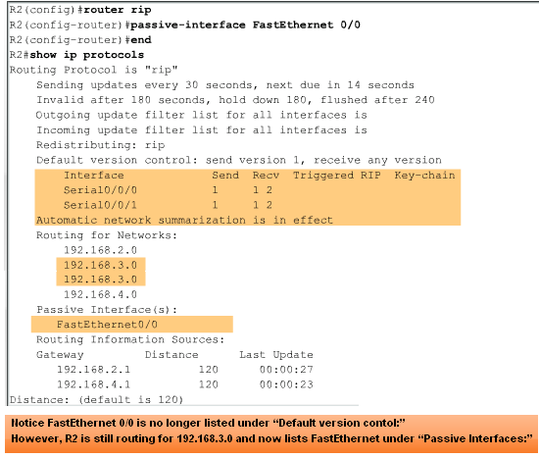
Verification and Troubleshooting
Passive interfaces

Slide 14
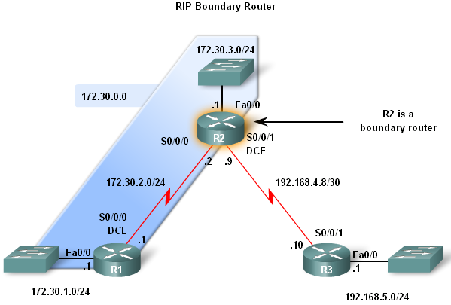
Automatic Summarization
Boundary Routers
  RIP automatically summarizes classful networks
  Boundary routers summarize RIP subnets from one major network to another.

Slide 15
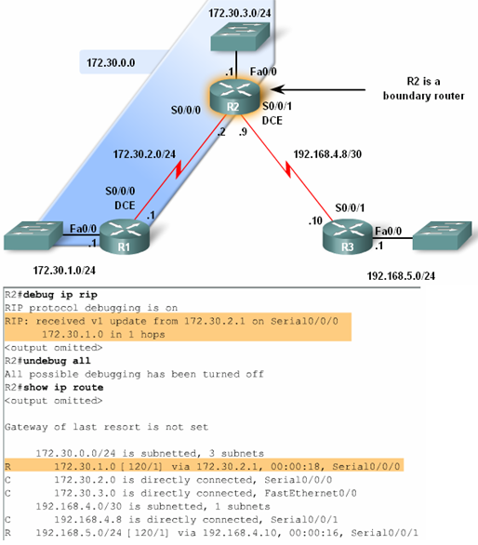
Automatic Summarization
Processing RIP Updates
2 rules govern RIPv1 updates:
-If a routing update and the interface it’s received on belong to the same network then
The subnet mask of the interface is applied to the network in the routing update
-If a routing update and the interface it’s received on belong to a different network then
The classful subnet mask of the network is applied to the network in the routing update.

Slide 16
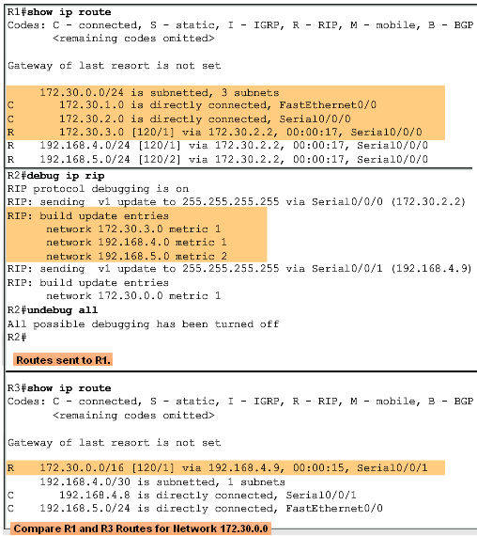
Automatic Summarization
Sending RIP Updates
  RIP uses automatic summarization to reduce the size of a routing table.

Slide 17
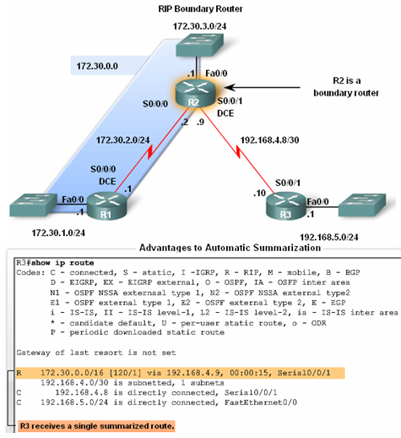
Automatic Summarization
Advantages of automatic summarization:
  The size of routing updates is reduced
  Single routes are used to represent multiple routes which results in faster lookup in the routing table.
  Stability in routing table

Slide 18
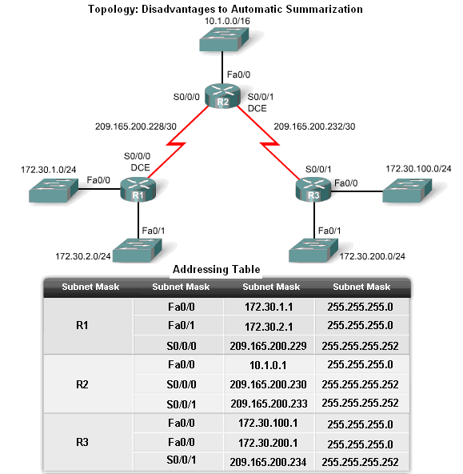
Automatic Summarization
Disadvantage of Automatic Summarization:
-Does not support discontiguous networks

Slide 19
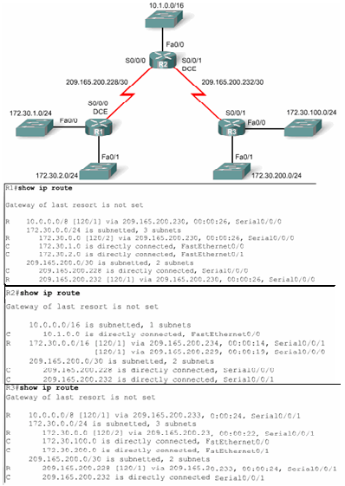
Automatic Summarization
Discontiguous Topologies do not converge with RIPv1
A router will only advertise major network addresses out interfaces that do not belong to the advertised route.

Slide 20
Default Route and RIPv1
Default routes
  Packets that are not defined specifically in a routing table will go to the specified interface for the default route
  Example: Customer routers use default routes to connect to an ISP router.
  Command used to configure a default route is
  ip route 0.0.0.0 0.0.0.0 s0/0/1

Slide 21
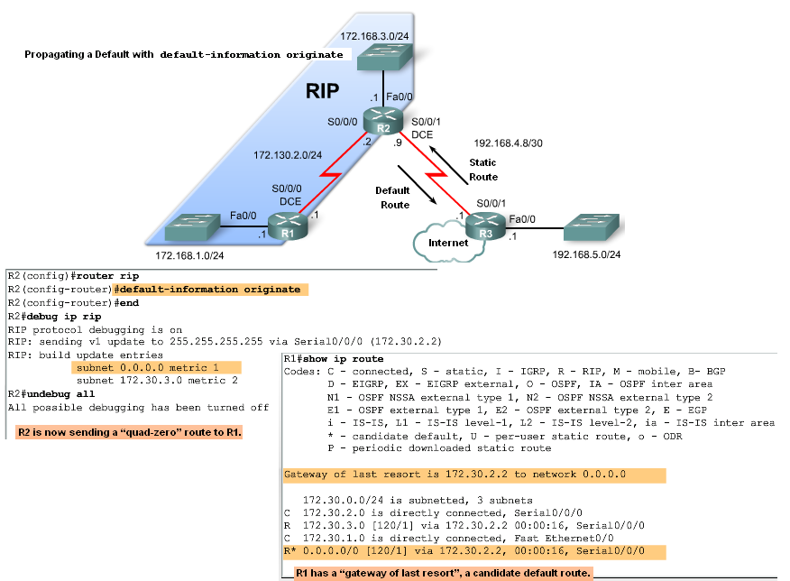
Default Route and RIPv1
Propagating the Default Route in RIPv1
Default-information originate command
  -This command is used to specify that the router is to originate default information, by propagating the static default route in RIP update.

Slide 22
Summary: Commands used by RIP
Command | Command’s purpose
Rtr(config)#router rip | Enables RIP routing process
Rtr(config-router)#network | Associates a network with a RIP routing process
Rtr#debug ip rip | used to view real time RIP routing updates
Rtr(config-router)#passive-interface fa0/0 | Prevent RIP updates from going out an interface
Rtr(config-router)#default-information originate | Used by RIP to propagate default routes
Rtr#show ip protocols | Used to display timers used by RIP

Slide 23
RIPv2

Slide 24
Introduction
Chapter focus
-Difference between RIPv1 & RIPv2
    RIPv1
        -A classful distance vector routing protocol
        -Does not support discontiguous subnets
        -Does not support VLSM
        -Does not send subnet mask in routing update
        -Routing updates are broadcast
    RIPv2
-A classless distance vector routing protocol that is an enhancement of RIPv1’s features.
-Next hop address is included in updates
-Routing updates are multicast
-The use of authentication is an option

Slide 25
Introduction
Similarities between RIPv1 & RIPv2
-Use of timers to prevent routing loops
-Use of split horizon or split horizon with poison reverse
-Use of triggered updates
-Maximum hop count of 15

Slide 26
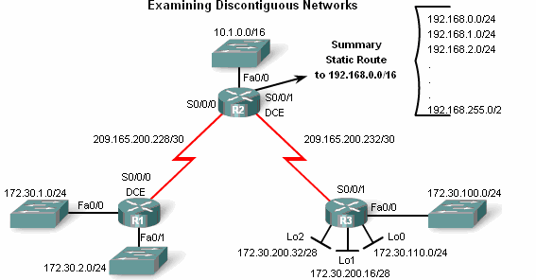
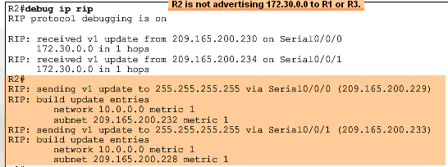
RIPv1 Limitations
  Examining the routing tables
-To examine the contents of routing updates use the
debug ip rip command
-If RIPv1 is configured then
Subnet masks will not be included with the network address

Slide 27
Configuring RIPv2
Enabling and Verifying RIPv2
Configuring RIP on a Cisco router
By default it is running RIPv1

Slide 28
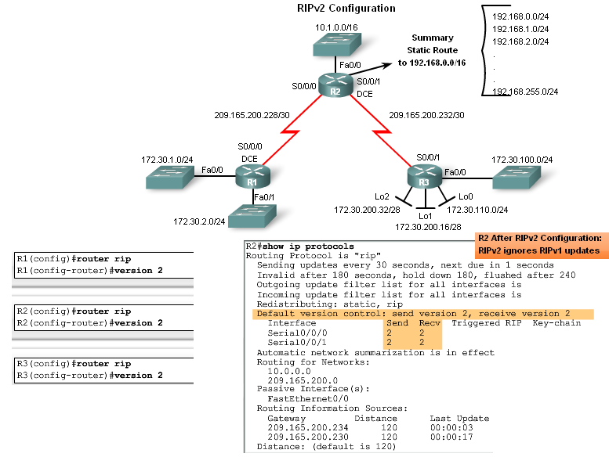
Configuring RIPv2
Configuring RIPv2 on a Cisco router
-Requires using the version 2 command
-RIPv2 ignores RIPv1 updates
To verify RIPv2 is configured use the
show ip protocols command

Slide 29
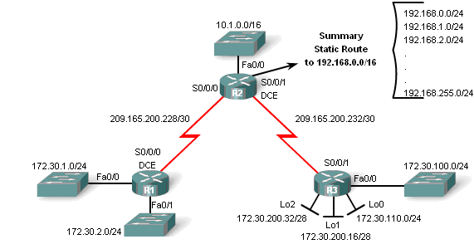
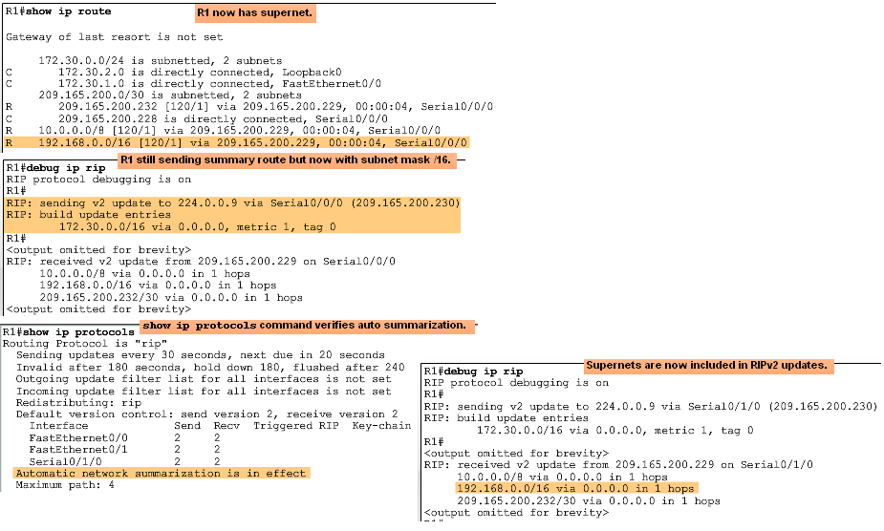
Configuring RIPv2
Auto-Summary & RIPv2
RIPv2 will automatically summarize routes at major network boundaries and can also summarize routes with a subnet mask that is smaller than the classful subnet mask

Slide 30
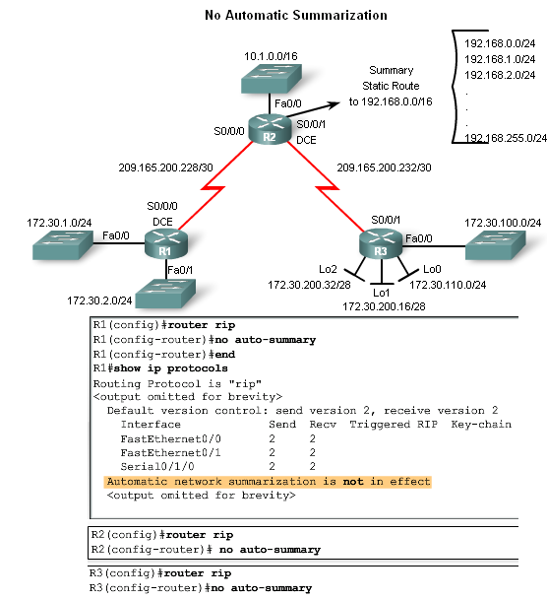
Configuring RIPv2
Disabling Auto-Summary in RIPv2
To disable automatic summarization issue the no auto-summary command

Slide 31
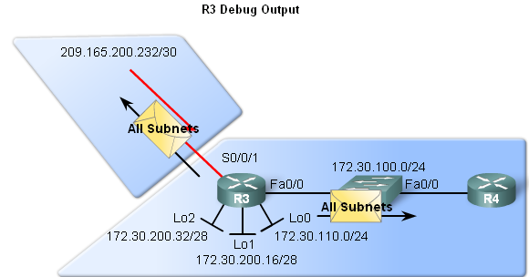
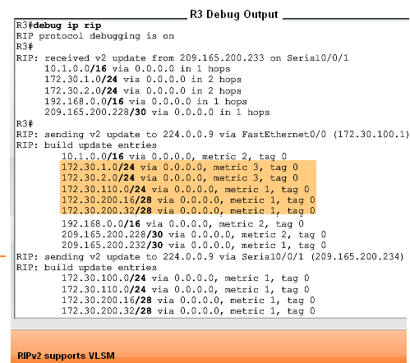
VLSM & CIDR
Networks using a VLSM IP addressing scheme
Use classless routing protocols (i.e. RIPv2) to disseminate network addresses and their subnet masks

Slide 32
Verifying & Troubleshooting RIPv2
Basic Troubleshooting steps
-Check the status of all links
-Check cabling
-Check IP address & subnet mask configuration
-Remove any unneeded configuration commands
Commands used to verify proper operation of RIPv2
  Show ip interfaces brief
  Show ip protocols
  Debug ip rip
  Show ip route

Slide 33
Verifying & Troubleshooting RIPv2
Common RIPv2 Issues
When trouble shooting RIPv2 examine the following issues:
    Version
Check to make sure you are using version 2
    Network statements
Network statements may be incorrectly typed or missing
    Automatic summarization
If summarized routes are not needed then disable automatic summarization

Slide 34
Verifying & Troubleshooting RIPv2
Reasons why it’s good to authenticate routing information
-Prevent the possibility of accepting invalid routing updates
-
Types of routing protocols that can use authentication
-RIPv2
-EIGRP
-OSPF
-IS-IS
-BGP

Slide 35
Summary
Routing Protocol | Distance Vector | Classless Routing Protocol | Uses Hold-Down Timers | Use of Split Horizon or Split Horizon w/ Poison Reverse | Max Hop count = 15 | Auto Summary | Support CIDR | Supports VLSM | Uses Authen-tication
RIPv1 | Yes | No | Yes | Yes | Yes | Yes | No | No | No
RIPv2 | Yes | Yes | Yes | Yes | Yes | Yes | Yes | Yes | Yes

